Slide 1
Embedded AI: Study and Implementation of TensorFlow Lite for Microcontrollers
Arouch Salma - Tber Zakaria - Thierry Elouan - Msallem Maysa

Slide 2
Summary
Introduction
Fall Detection
Movement Detection
Snow Detection
Conclusion
2

Slide 3

Introduction
Problem:
Falls are a major cause of injury among older adults.
Statistic: In France, nearly 400,000 older adults experience falls each year, with 100,000 resulting in hospitalizations and around 10,000 leading to fatal injuries (source: Public Health France).
Data:
Dataset: acc_gyr.csv.
Features: 6 sensor signals
Labels: Normal (0) and Fall (1).
3

Slide 4
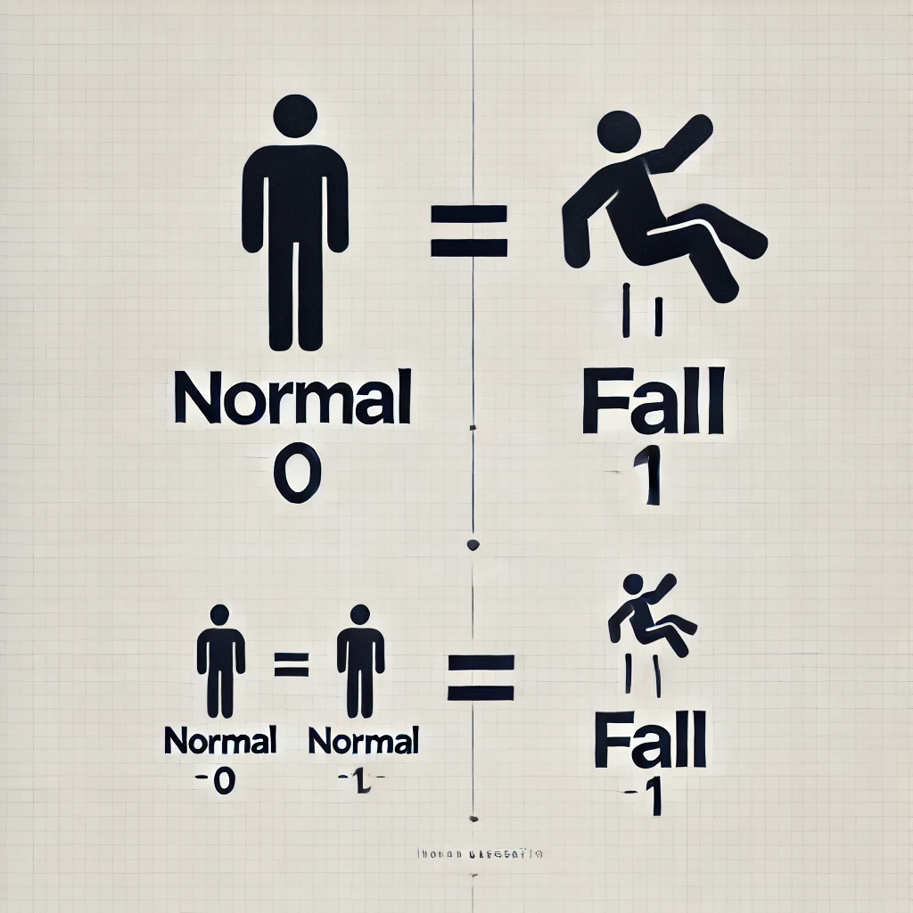
Data Preprocessing
Steps:
Reshaping data for sequence learning.(400 time steps)
Binary encoding of labels (Normal: 0, Fall: 1).
Balancing data using SMOTE.
Splitting into training (80%) and testing (20%).
Normalizing data with StandardScaler.
4

Slide 5

Model Design
Input: 400x6 sequences.
Architecture:
Conv1D with 4 filters and ReLU activation.
MaxPooling1D for feature reduction.
Dense layers for classification.
Output: Sigmoid activation for binary classification.
5

Slide 6
Training and Evaluation
Training:
Optimizer: Adam (learning rate = 0.001).
Loss: Binary cross-entropy.
100 epochs, batch size = 64.
Evaluation metrics:
Accuracy.
Confusion matrix.
6

Slide 7
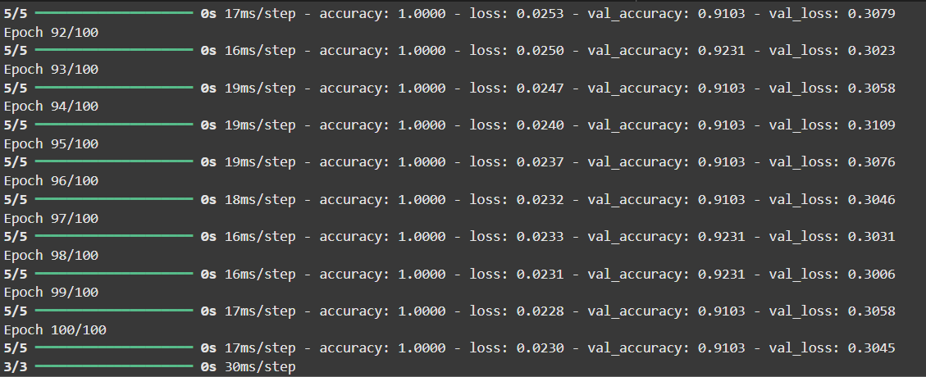
Results
7

Slide 8
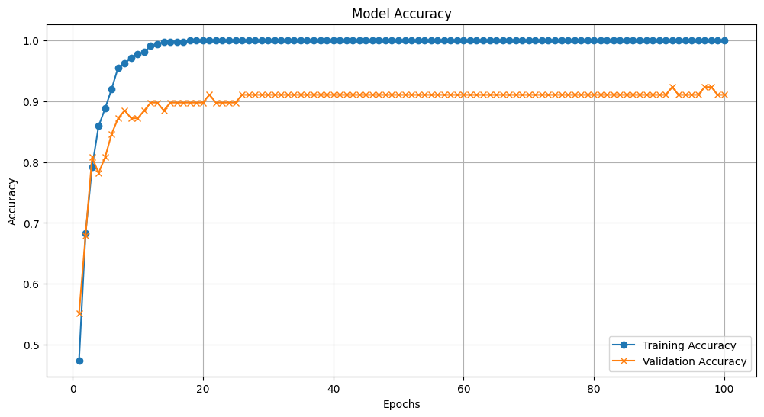
The accuracy curve
8

Slide 9
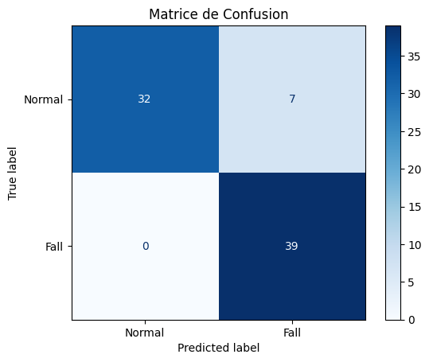
Confusion matrix
9

Slide 10
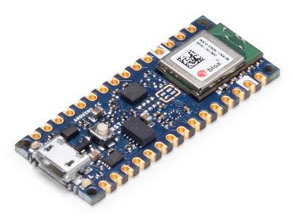
Deploying artificial intelligence in Arduino card
Convert Trained Model for Arduino
Get the Model Ready for Deployment: Convert it into a C Array
Using Arduino IDE to program the Arduino.
Fall detection using Arduino
10

Slide 11
Deploying artificial intelligence in Arduino card
10

Slide 12
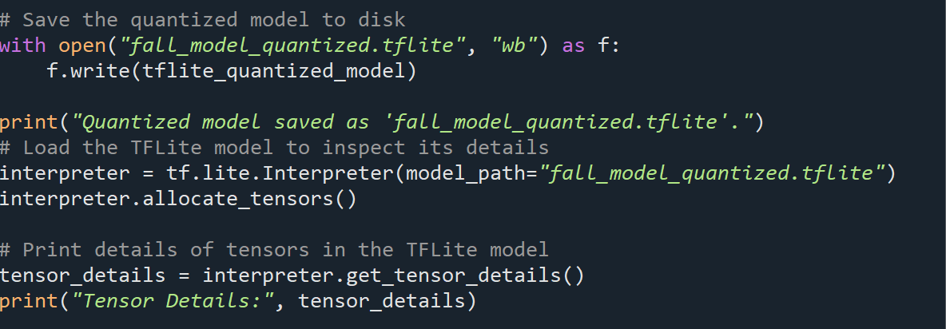

Convert Trained Model for Arduino
The model is quantized to make it smaller and faster, which is important for devices with limited resources.
The quantized model is saved as a .tflite file that can run on microcontrollers.
The saved model is loaded into a tool to check how it handles data and ensure it works correctly.
11

Slide 13
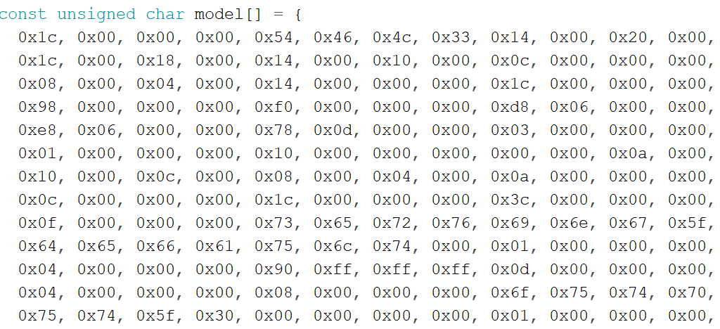
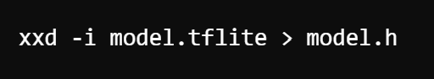
Get the Model Ready for Deployment: Convert it into a C Array
Convert the model into a format that can be used by the Arduino.
A simple tool (xxd) turns the model into a byte array (a long list of numbers).
This new file is added to the Arduino code, making the model ready to run.
Once included, the Arduino can use the model to make predictions directly.
12

Slide 14
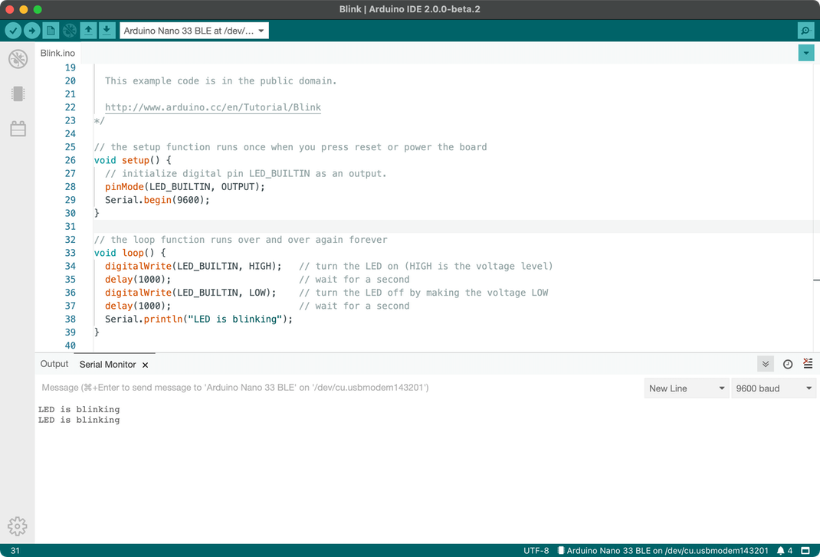
Using Arduino IDE to program the Arduino.
The Arduino IDE is the software used to write and upload code to the Arduino.
You write the code (sketch) in the IDE, which includes instructions for the Arduino to follow.
Once the code is ready, you can upload it directly to the Arduino board using a USB connection.
The Arduino then follows the uploaded instructions to perform tasks like making predictions using the model.
13

Slide 15
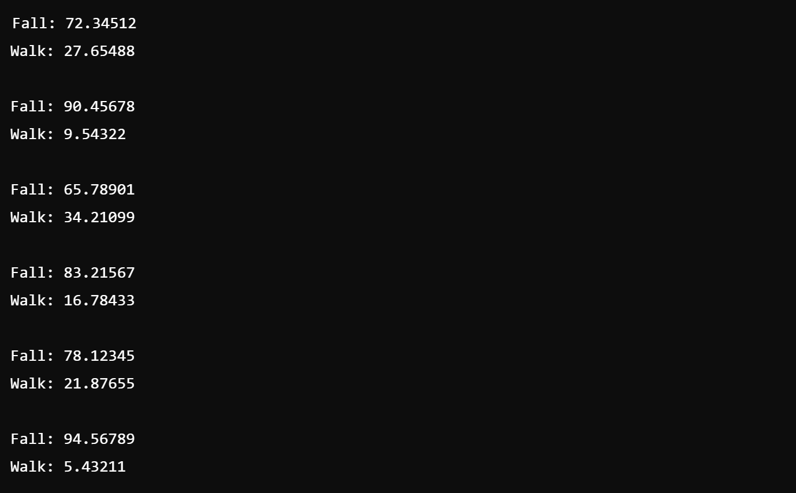
Fall detection using Arduino
14

Slide 16




Usecase: Difference Between Two Movements
Detection two movements -> Punch vs Flex
15

Slide 17

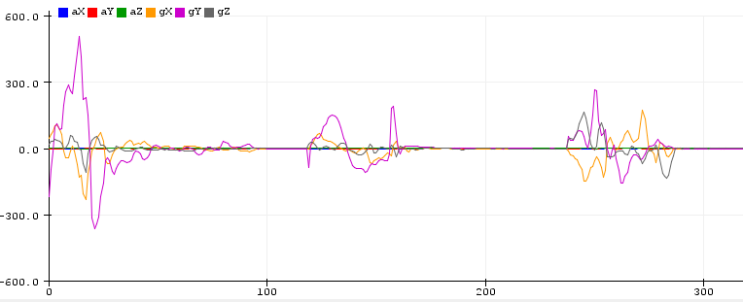
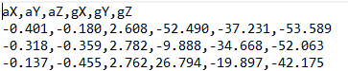
Database Creation
Generate .csv file
Sort file data
6-axis IMU sensor (accelerometer, gyroscope)
Recovery of sensor samples with Arduino IDE (40 patterns /movement)
16

Slide 18
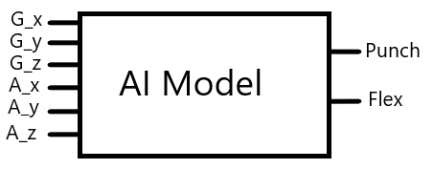
Neural Network Training
Separation of data into training and validation sets
Model with 6 input layers and 2 output layers
17

Slide 19

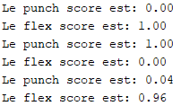
Recovering the AI Model
Soft max algorithm
Probabilities between 0 and 1
Sum equal to 1
Generation model.h file:
Binary representation of the trained neural network.
18

Slide 20
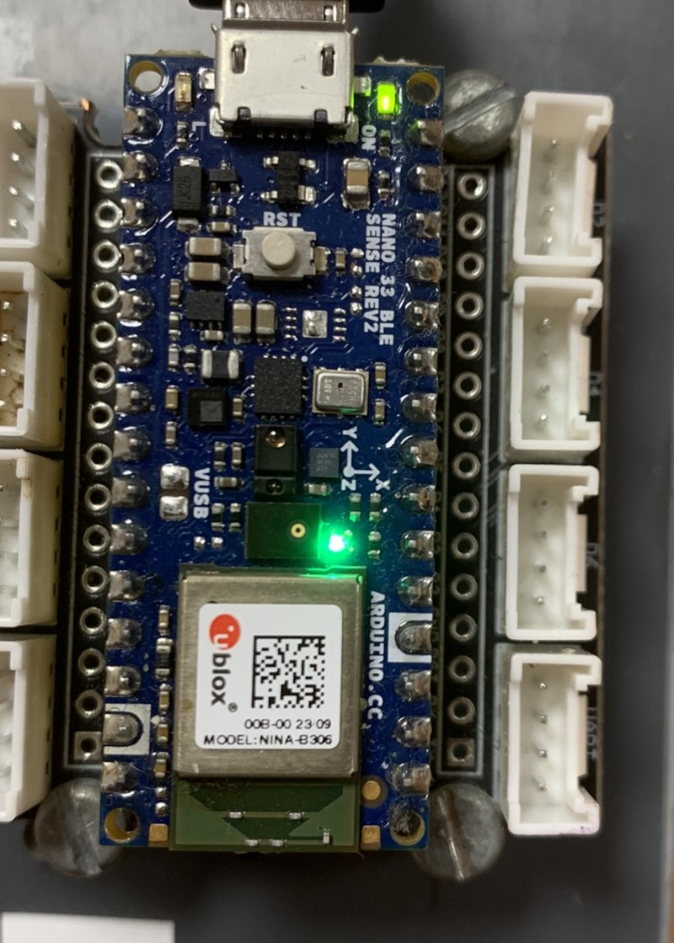
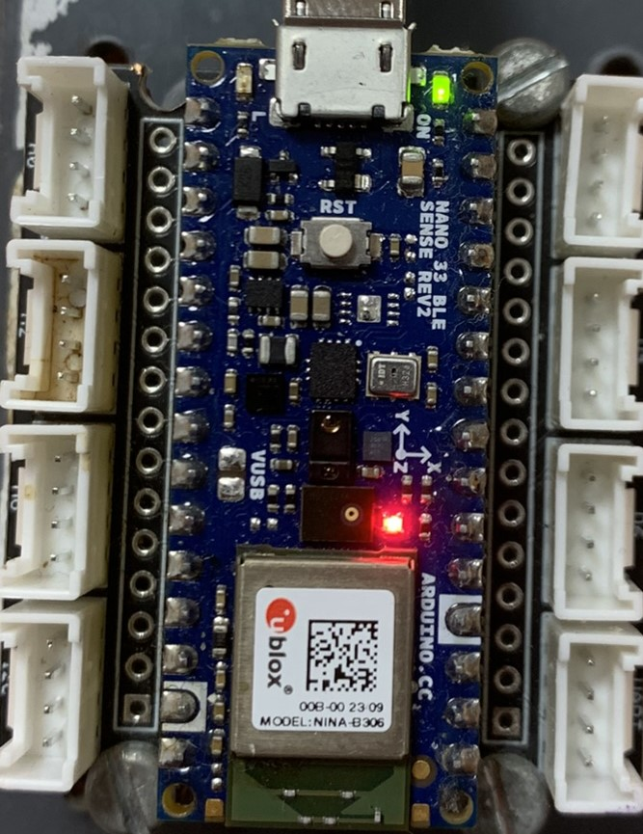
Arduino Coding
Introduction of the binary file containing the model
Comparison of output layer classes
Red LED vs Green LED
FLEX
PUNCH
19

Slide 21
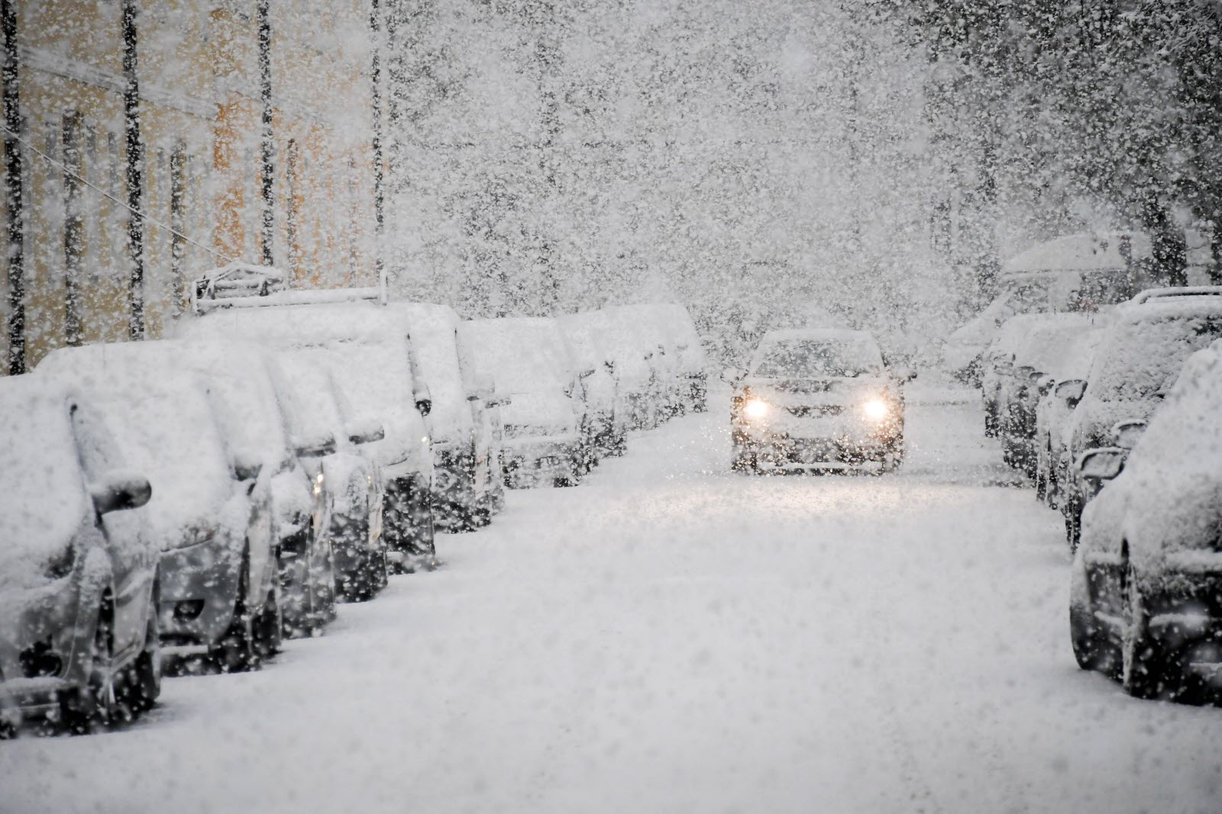
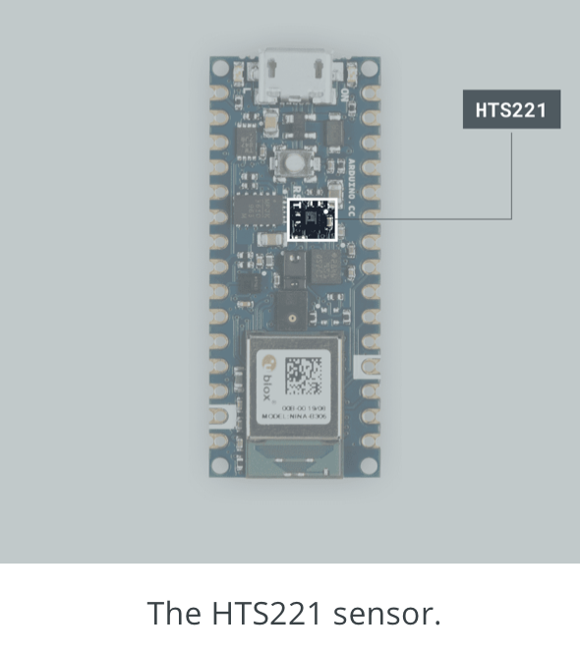
Use Case: Building a Weather Station
Mayssa on travaille sur canva mtn check ton mail
Purpose :
Detect Snow in real time with a neural network
Process :
Training the neural network on historical data
Parameters : Temperature, Humidity and Snow
Prediction using HTS221 Arduino sensors (Temperature and Humidity sensors)
20

Slide 22

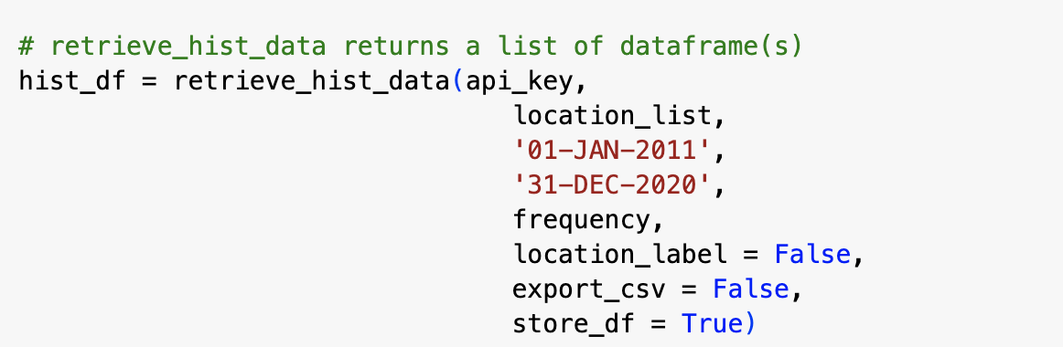
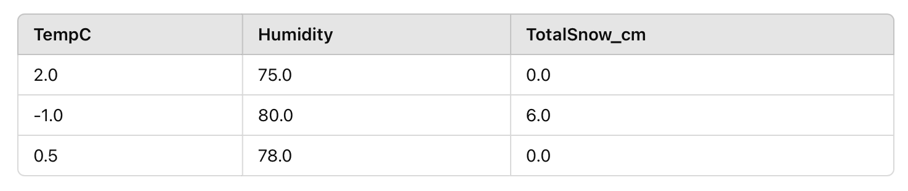
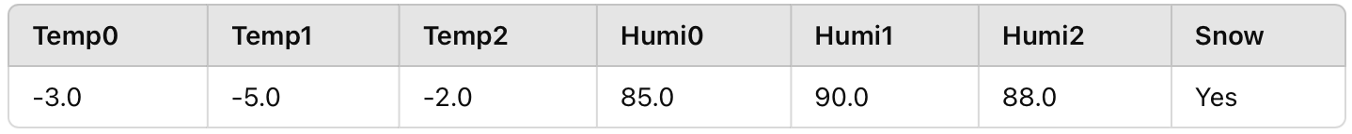
Data Collection with World Weather and Preprocessing
⇒
Preprocessing :
21

Slide 23
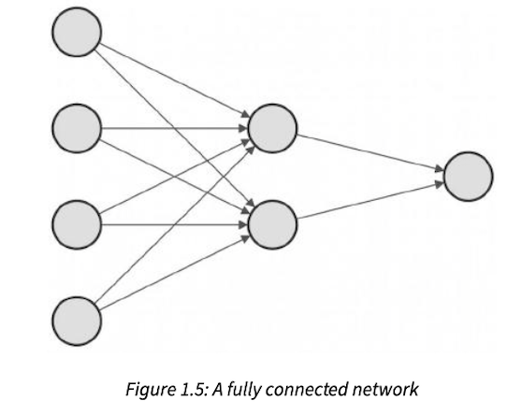
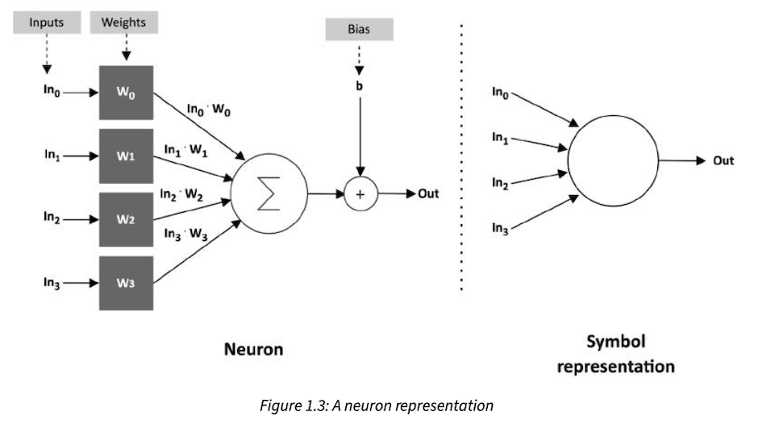
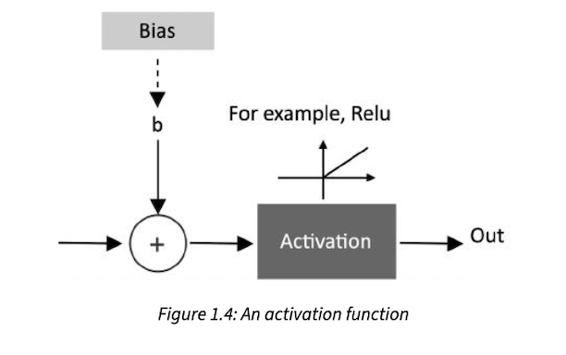
Neural Network Design and Training
22

Slide 24
Deployment on Arduino and Quantification
Process :
Download and import the TensorFlow Lite library for Arduino
Import the model.h file
Load the TensorFlow Lite model:
tflu_model = tflite::GetModel(snow_model_tflite);
Retrieve the quantization parameters of the tensors
23

Slide 25
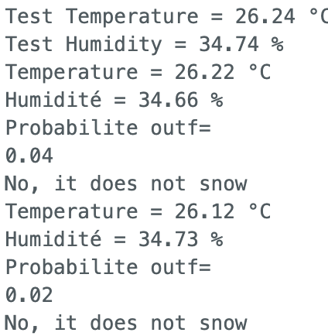
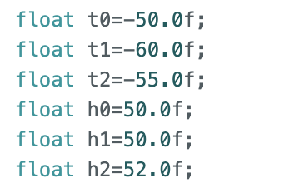
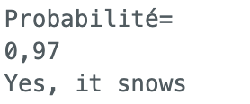
Real-Time Sensor Integration
Retrieve three temperature values and three humidity values over time at regular intervals to predict weather conditions.
Limit :
In Bordeaux, snowfall is relatively rare !
Therefore, we have hardcoded temperatures typically associated with snowfall.
24

Slide 26

Thank you!
25

Slide 27
Bibliography
BANERJEE, R. - Hands-on TinyML, BPB Online, 2023
GUPTA, A.K ; NANDYALA, S.P. - Deep learning on microcontrollers, BPB Online, 2023
IODICE, G.M. - TinyML Cookbook, Packt Publishing, 2023
26

